Slide 1
BIG DATA – LOGS ANALYSIS
DISCOVER THE HIDDEN TRUTH
TATIANA ZBONČÁKOVÁ, ADAM VAŇKO, MATÚŠ RAČEK

Slide 2
INPUT DATA
Log files in CSV format
Message column contained multiple attributes
Ad-hoc parsing solution using Python
Importing processed log files into database
Slow
Easy to make a mistake

Slide 3
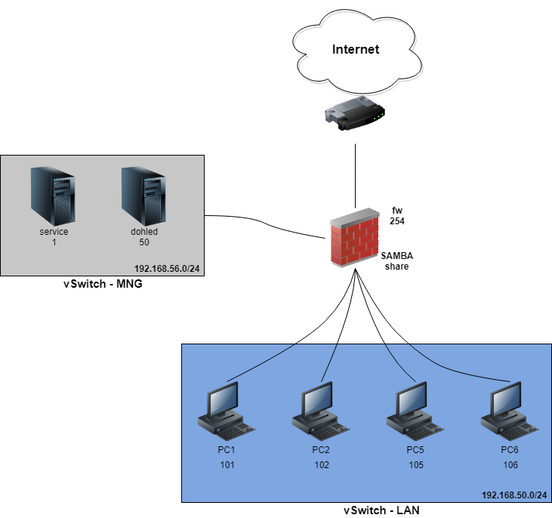
NETWORK
TOPOLOGY

Slide 4
FIREWALL
Detection of SSH/Telnet attack with dictionary
SELECT SRC, DST, COUNT(*) numberOfAttempts
FROM [skodahacker1].[dbo].[firewal3]
GROUP BY SRC, DST, PROTO, DPT
HAVING SRC NOT LIKE '192.168.56.%' AND SRC NOT LIKE '192.168.50.%' AND PROTO = 'TCP' AND DPT = 22(23 Telnet)
ORDER BY numberOfAttempts DESC
Results: 0 rows
Detection of Telnet Anomaly
Same query as SSH only with DPT = 23.
Results: Nothing abnormal was found.

Slide 5
FIREWALL
Detection of DDoS attack
SELECT SRC, PROTO, COUNT(*) cnt
FROM [skodahacker1].[dbo].[firewal3]
GROUP BY SRC, PROTO
HAVING COUNT(*) > 10
ORDER BY PROTO, cnt DESC
SRC | PROTO | cnt
192.168.56.50 | ICMP | 500
192.168.50.102 | TCP | 139611
192.168.50.101 | TCP | 135826
192.168.50.105 | TCP | 127826
192.168.50.106 | TCP | 47005
192.168.56.50 | TCP | 14069
192.168.50.102 | UDP | 130987
192.168.50.105 | UDP | 128882
192.168.50.101 | UDP | 124611

Slide 6
FIREWALL
Detection of the vertical port scan
SELECT SRC, DST, COUNT(*) numberOfConnections, COUNT(DISTINCT(DPT)) AS numberOfPortScans
FROM [skodahacker1].[dbo].[firewal3]
GROUP BY SRC, DST
HAVING SRC NOT LIKE('192.168.50.%') AND
SRC NOT LIKE('192.168.56.%')
ORDER BY numberOfPortScans DESC
Detection of the horizontal port scan
SELECT SRC, DPT, COUNT(*) numberOfConnections, COUNT(DISTINCT(DST)) AS numberOfScannedIPs
FROM [skodahacker1].[dbo].[firewal3]
GROUP BY SRC, DPT
HAVING SRC NOT LIKE '192.168.56.%' AND
SRC NOT LIKE '192.168.50.%'
ORDER BY numberOfScannedIPs DESC
Results: Discovery of two local IPs (10.0.2.15, 10.0.2.2 1 ) which were receiving packets from the outside world.

Slide 7
FIREWALL
Results of the horizontal and vertical port scans
No information about the discovered nodes
10.0.2.15 is communicating with node in China (123.103.93.214)
No attacks from the outside
Possible inside threats
Analysis of the inner traffic
Detected scan attack on firewall from internal node

Slide 8
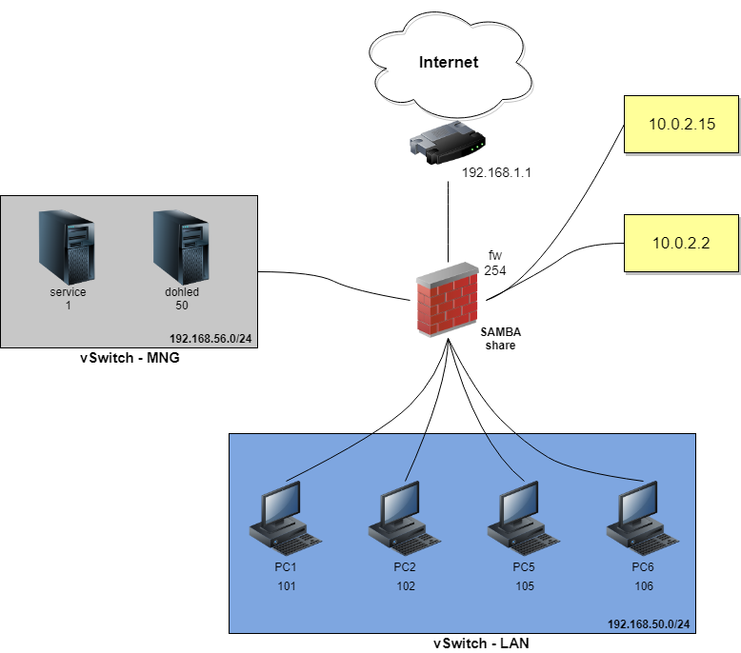
NETWORK TOPOLOGY REVISITED

Slide 9
LOCAL NETWORK
Vertical scan attack detection
SELECT [Application Name] AppName,[SourceAddress], [DestinationAddress], COUNT(*) AS TotalCount, (COUNT(DISTINCT([Destination Port]))*1.0 / COUNT(*)) uniquePortsRatio
FROM [skodahacker1].[dbo].[processed_PC6_security]
GROUP BY [Application Name],[Source Address], [Destination Address]
HAVING COUNT(*) > 100
ORDER BY uniquePortsRatio DESC
AppName | SourceAddress | DestinationAddress | TotalCount | UniquePortsRatio
svchost.exe | 239.255.255.250 | 192.168.50.101 | 9941 | 0.220199175133
svchost.exe | 239.255.255.250 | 192.168.50.105 | 8726 | 0.207540683016
chrome.exe | 192.168.50.106 | 93.184.220.66 | 104 | 0.019230769230
chrome.exe | 192.168.50.106 | 192.0.77.32 | 106 | 0.018867924528

Slide 10
LOCAL NETWORK
Horizontal scan attack detection
SELECT [Application Name] AppName, [Source Address], [Destination Port], COUNT(*) AS TotalCount, (COUNT(DISTINCT([Destination Address]))*1.0 / COUNT(*)) uniqueAddressRatio
FROM [skodahacker1].[dbo].[processed_PC6_security]
GROUP BY [Application Name],[Source Address], [Destination Port]
HAVING COUNT(*) > 100
ORDER BY uniqueAddressRatio DESC
AppName | Source Address | Destination Port | TotalCount | uniqueAddressRatio
System | 192.168.50.106 | 137 | 4829 | 0.37274798094
chrome.exe | 192.168.50.106 | 80 | 6656 | 0.18659855769
chrome.exe | 192.168.50.106 | 443 | 52341 | 0.09266158460
chrome.exe | 192.168.50.106 | 53 | 277 | 0.01083032490

Slide 11
LOCAL NETWORK
Process hash checking
SELECT [Image], [FIleVersion], COUNT(*)
FROM [skodahacker1].[dbo].[processed_PC2_sysmon]
GROUP BY [Image], [FileVersion]
HAVING COUNT(DISTINCT(Hashes)) > 1
Children processes count
SELECT [ParentProcessId], [ParentCommandLine],Company, COUNT(*) AS ChildrenCount
FROM [skodahacker1].[dbo].[processed_PC5_sysmon]
GROUP BY [ParentProcessId], [ParentCommandLine], [Company]
ORDER BY childrenCount DESC
ParentProcessId | ParentCommandLine | Company | ChildrenCount
 |  |  | 858901
2940 | "TrafficSimulator_browser_Chrome.exe" | Google Inc. | 3183
1772 | "TrafficSimulator_browser_Chrome.exe" | Google Inc. | 2163
www.virustotal.com

Slide 12
LOCAL NETWORK
Driver signature checking
SELECT [Message], ImageLoaded, Hashes, [Signature], Signed
FROM [skodahacker1].[dbo].[processed_PC1_sysmon]
GROUP BY [Message], ImageLoaded, Hashes, [Signature], Signed
HAVING [Message] = 'Driver loaded:'

Slide 13
OTHER TECHNIQUES
Deletion of the event log files
Reconfiguration of the firewall
Monitoring the number of wrong log-in tries
Applications and system crashes
Priviliges migration

Slide 14
THANK YOU FOR YOUR ATTENTION

